Slide 1
Pasadena ISD AVID students rock Texas
legislators at school house event!
Four amazing Pasadena ISD AVID students were selected to represent San Jacinto Intermediate at the 2015 installment of the Texas Capitol Schoolhouse. The Texas Capitol Schoolhouse is a legislative event designed to give students and teachers from across the state of Texas the opportunity to showcase how technology is being used to improve public schools. The goal of the event is to provide information for legislators, other state leaders, and the general public about how the most advanced technologies and best practices are changing the way teachers teach and students learn. The event is held annually in Austin at the State Capitol Rotunda with San Jacinto Intermediate being only one of ten schools, state wide invited to attend. The students proudly showed off their use of Microsoft Office 365 highlighting their completely electronic OneNote binder, e-mail, calendar and planner capabilities. The students were even interviewed by local Austin news affiliate KVUE and wowed reporter Quita Culpepper with their tech savvy knowledge and skills. Through this pioneering use of technology, San Jacinto Intermediate AVID students are reshaping learning in the state of Texas and preparing to be successful global citizens in our rapidly advancing society. The following slideshow was created by AVID students to showcase schoolwide technology use.

Slide 2
San Jacinto Intermediate Pasadena ISD
TIGERS can’t hide that 1:1 PRIDE!

Slide 3
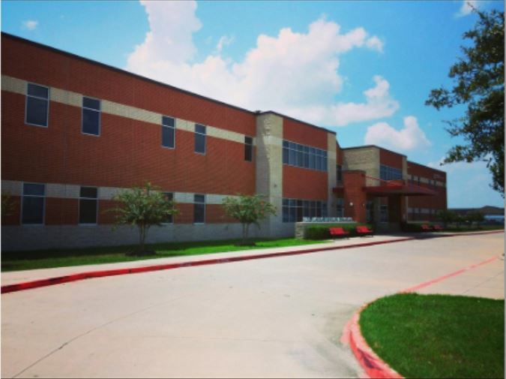

Slide 12
Advancement Via Individual Determination

Slide 15
HIGH TECH PEP RALLY COMPETITION!

Slide 20
Our SUCCESS students LOVE their TECH TIME !

Slide 30
TECHNOLOGY MAKES US SMILE…

Slide 32
TAYLOR POE - AVID AMBASSADOR

Slide 33
ALAZAE RUBALCAVA – AVID AMBASSADOR

Slide 34
ZACH SHANNON – AVID AMBASSADOR

Slide 35
EMILY VASQUEZ – AVID AMBASSADOR

Slide 37
"I'm a great believer that any tool that enhances communication has profound effects in terms of how people can learn from each other and how they can achieve the kind of freedoms that they're interested in.“ --- Bill Gates

